Slide 1


SAP UI5 & FIORI with OData TRAINING
Anubhav Oberoy
Day – 17

Slide 2

Agenda – Day 17
Deep inserts
Basics of Connectivity
Steps to Setup the Cloud Connection.
Creating the destination in the BAS
Connecting with cloud connector in BTP
Integrating our Fiori App with the Odata service in BAS
Configuring ui5.yaml file to use oData service in VS Code
Implementing the Get Entity Set in UI
Getting the Association in UI
Implementing Create in the UI
Implementing Upadte in UI
Implementing Delete uisng UI
Calling Function Import form the UI
Introduction to GitHub
Creating a Git Repository in GitHub.
Understanding How to deliver Fiori Apps
Deploying the App to ABAP Enviornment
Introduciton to Fiori Launchpad
Why we need a Launchpad
How to Access Launchpad
Basic Terms related to Launchpad
Relation between Front-End Components
Creating Fiori App uisng Template in BAS
Creating Fiori App uisng Template in VS Code
Fiori UX Consistency
Introduciton to Fiori Elements
Free Style v/s Fiori Elements Apps
Developer Persona – Fiori Elements
Introduction to Annotaions.
List Report Application – Fiori Element
Analytic List Page – Fiori Element

Slide 3


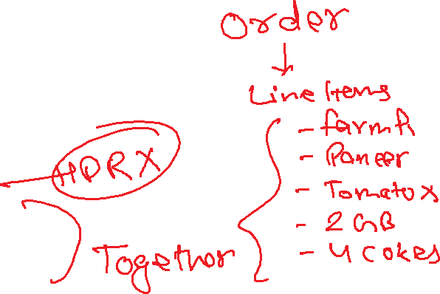



Slide 5

Basics of Connectivity and Role of SCC
Internet
Intranet
SAP BW
SAP ECC
SAP S/4 Hana
SAP BTP (PublicCloud)
SAP Cloud Connector
SAP On-premise System
SAP Business Application Studio
SCC
Destination
S/4 Hana Cloud
Field Glass
Sales Force

Slide 6
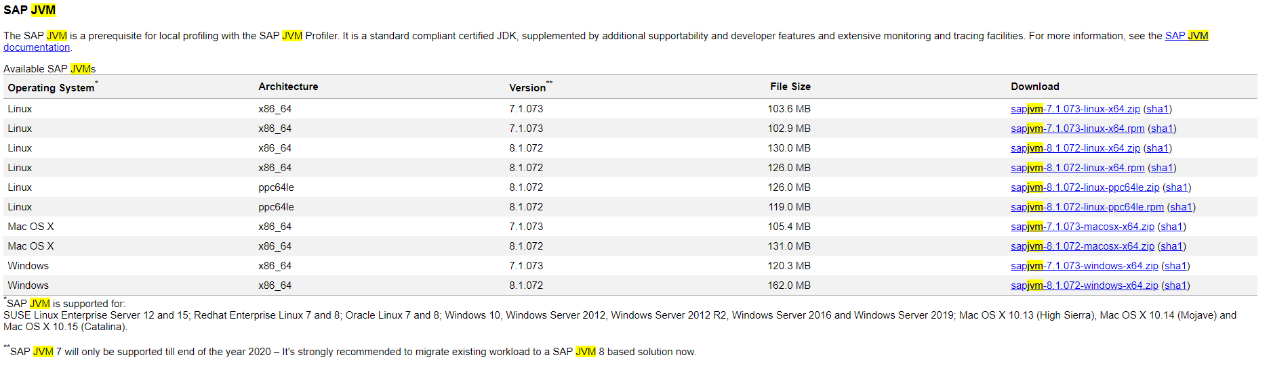
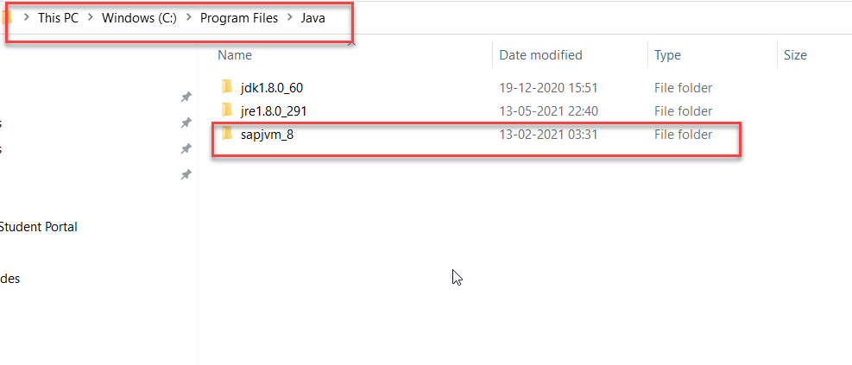
Cloud Connector
Step 1: Download SAP JVM and Extract it in the C:\Program Files\Java

Slide 7
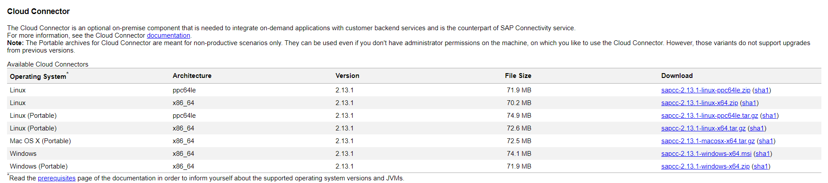
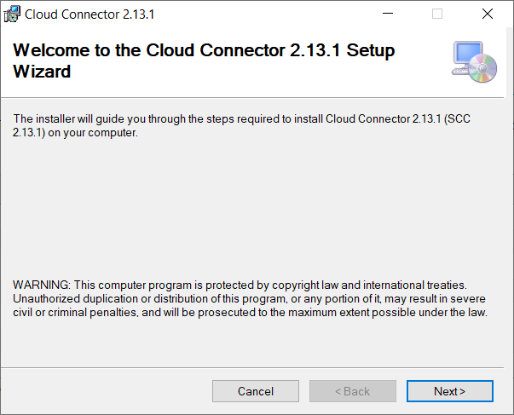
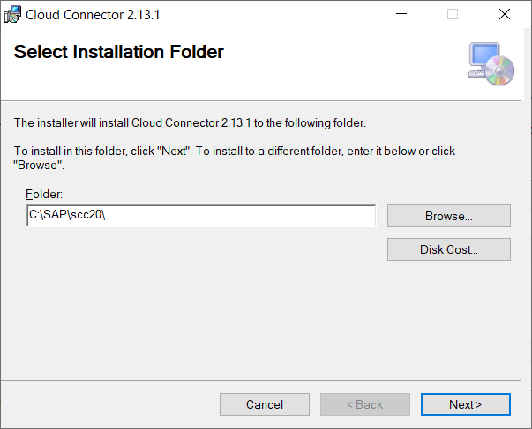
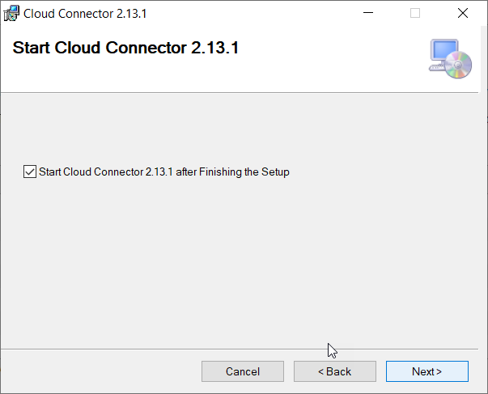
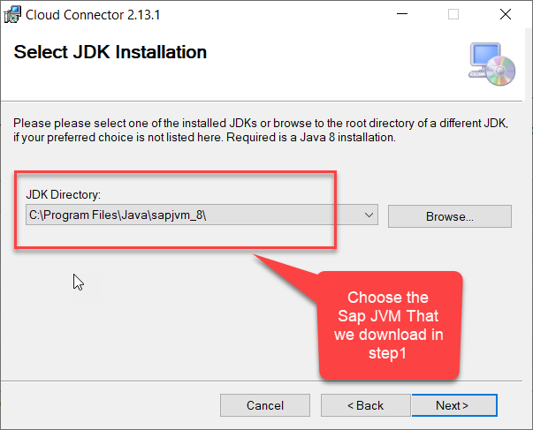
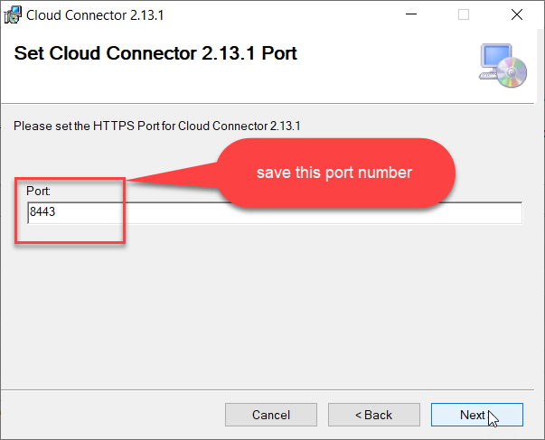
Cloud connector continue…
Step 2: Download and install the sap Cloud connector

Slide 8
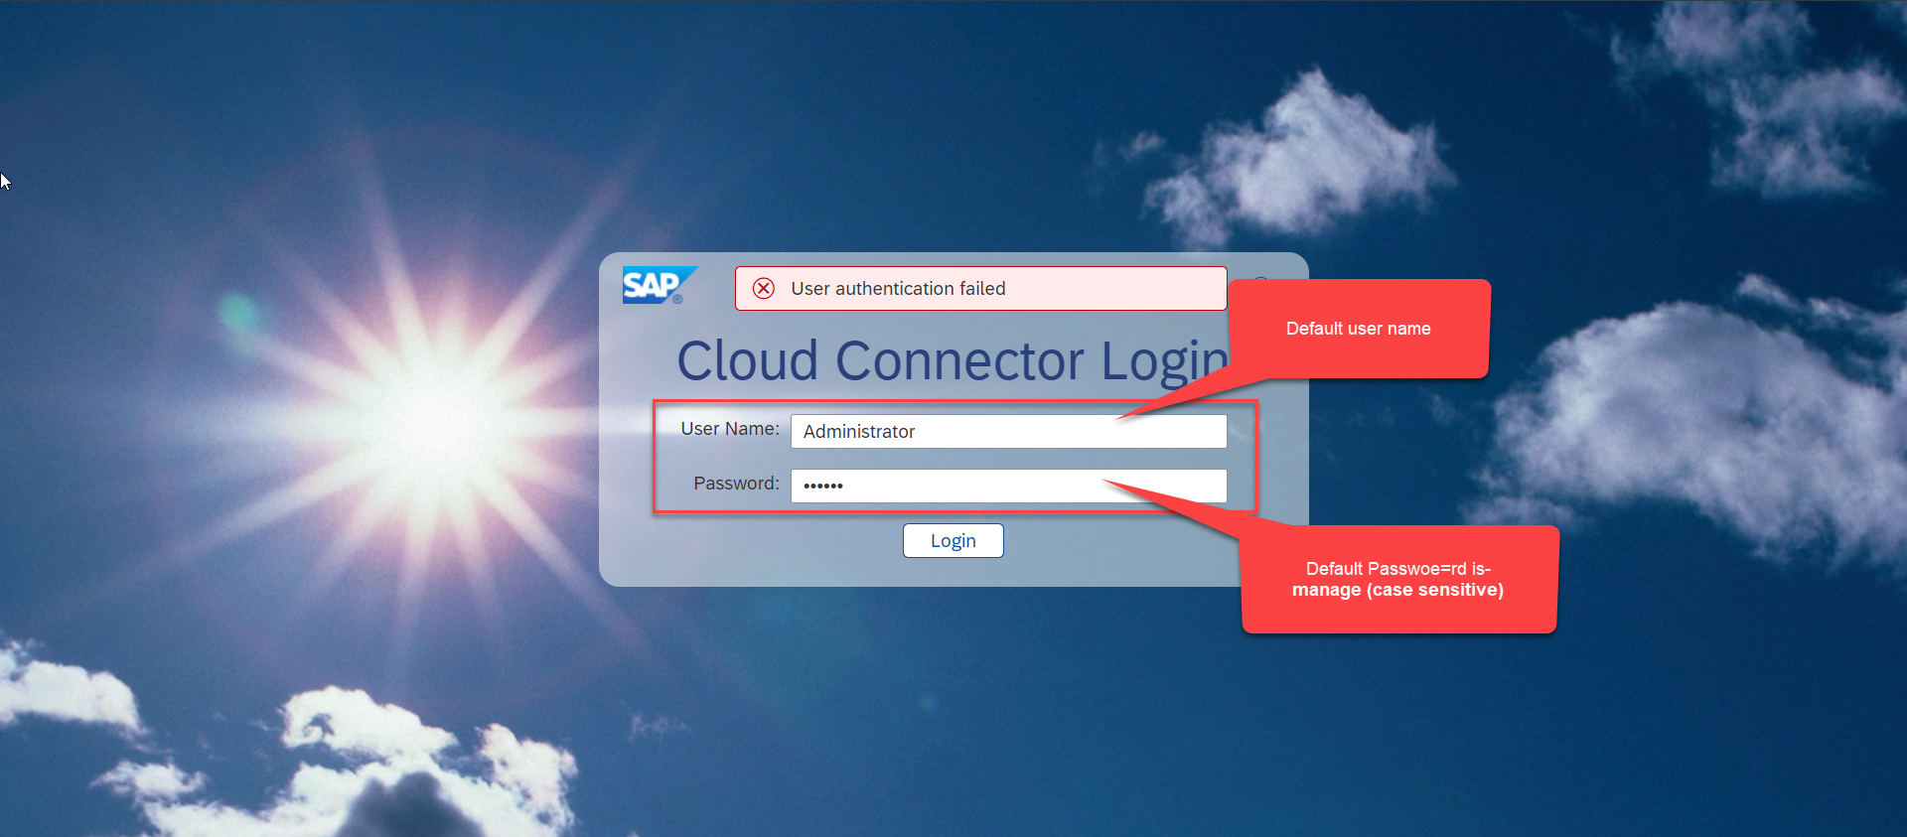
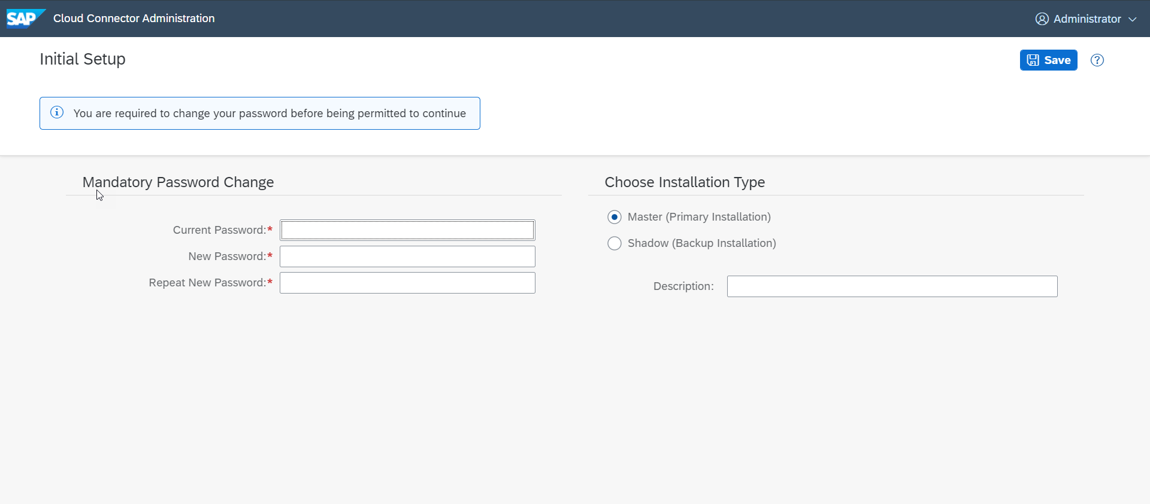
Cloud connector continue…
Step 3: Now your system is ready go to browser and open https://localhost:8443 (port may changes)
The default credentials are Administrator / manage

Slide 9
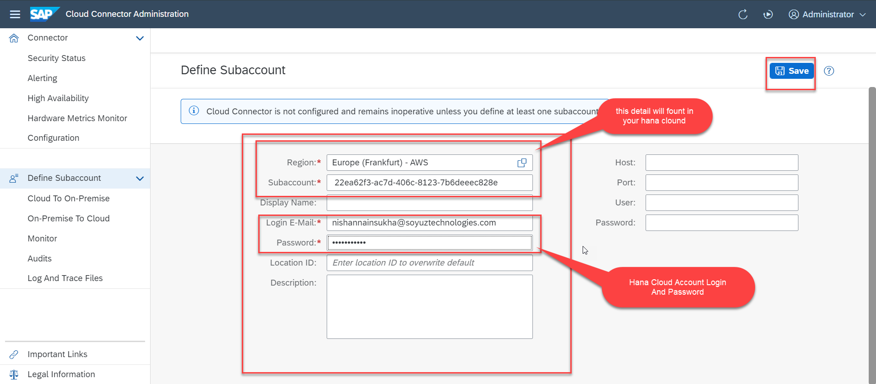
Cloud connector continue…
Step 4: Now we create a connection with our Cloud Account

Slide 10
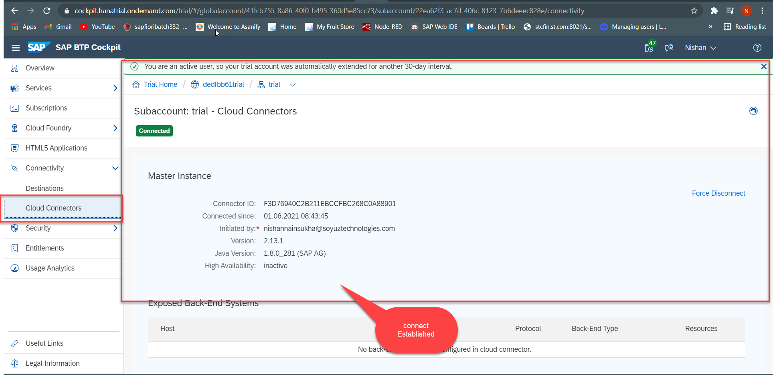
Cloud connector continue…
Step 5: Check the connection on Hana Cloud Account

Slide 11
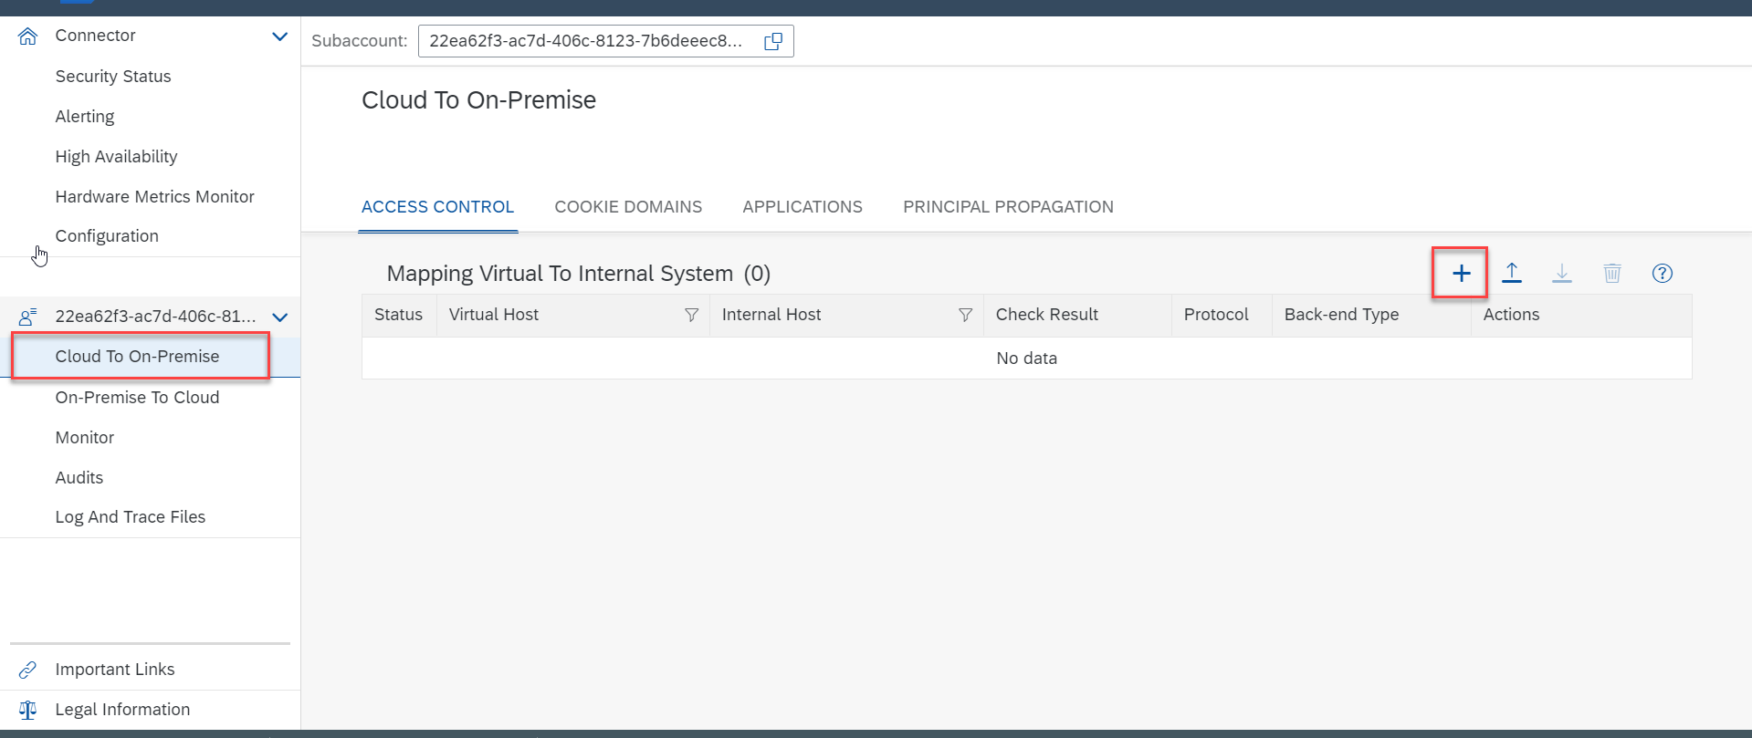
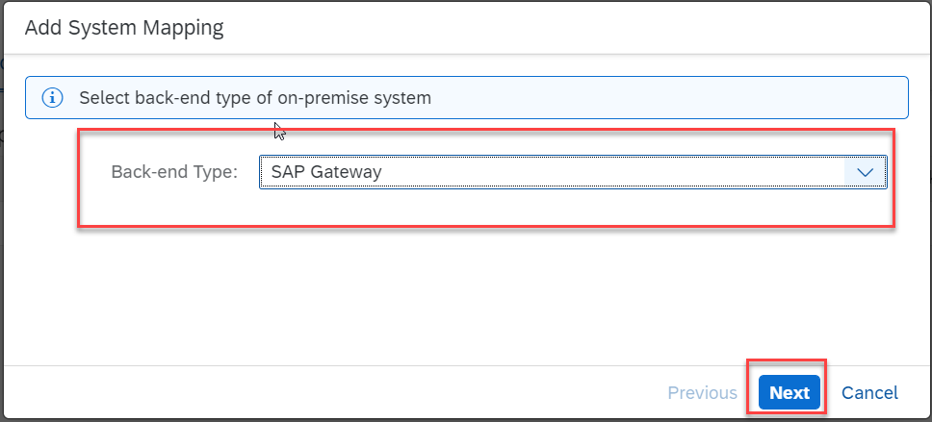
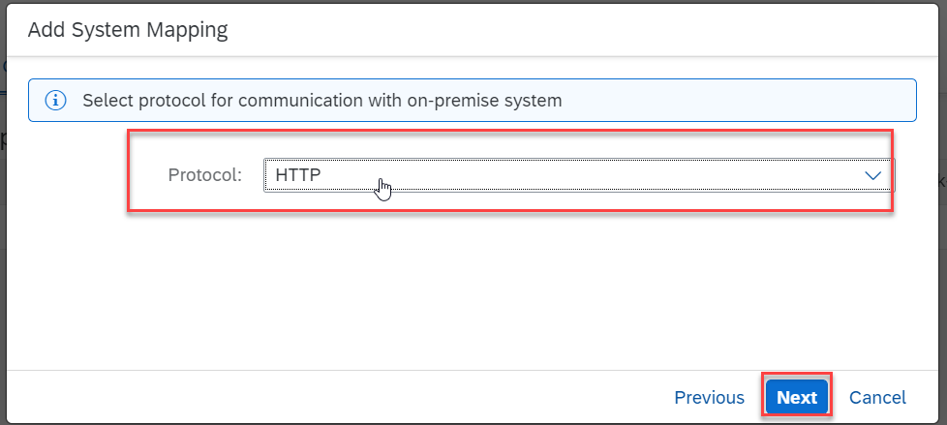
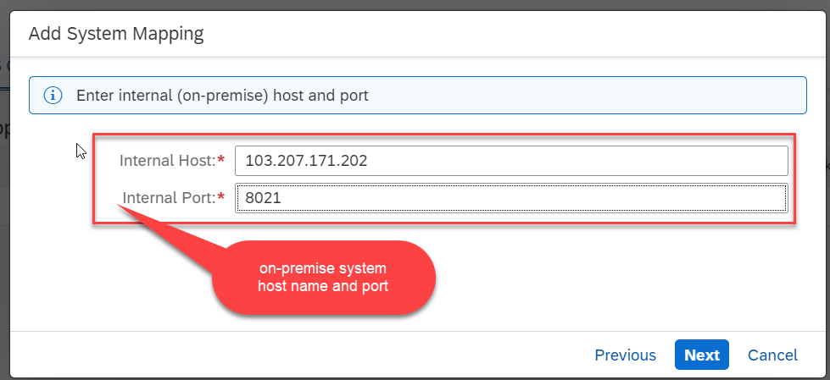
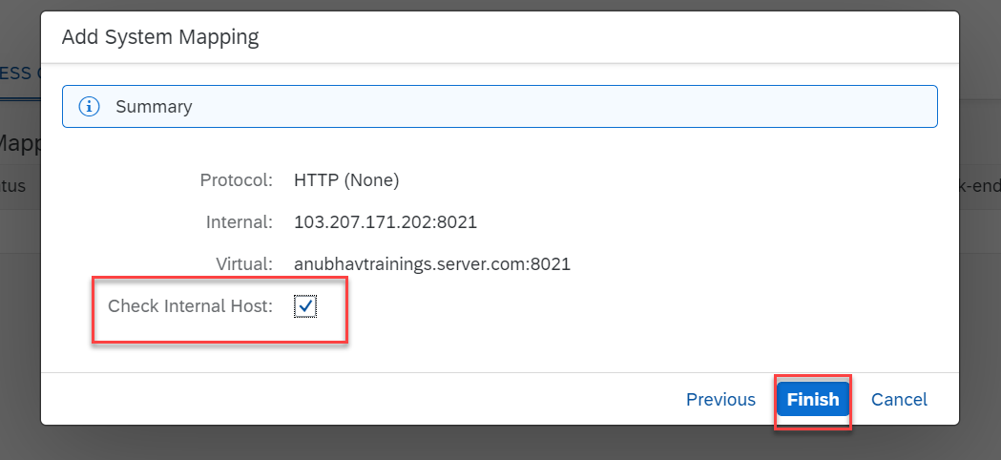
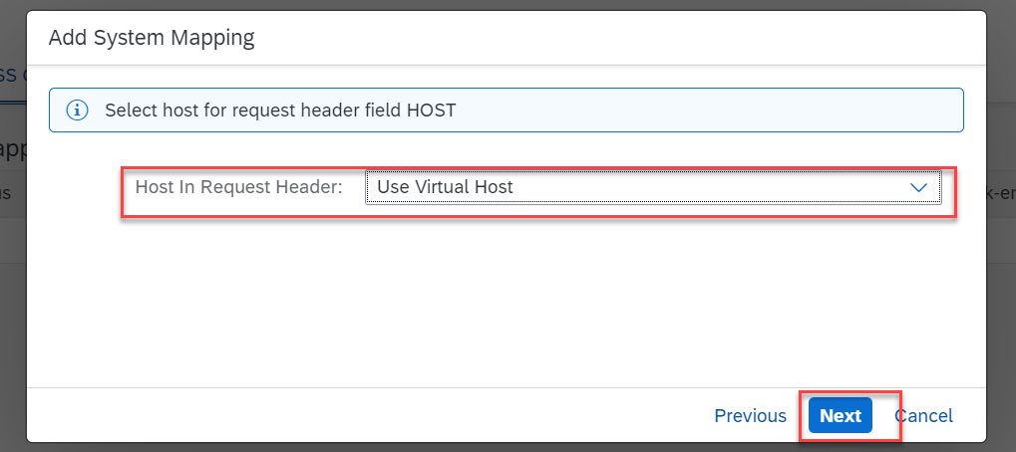
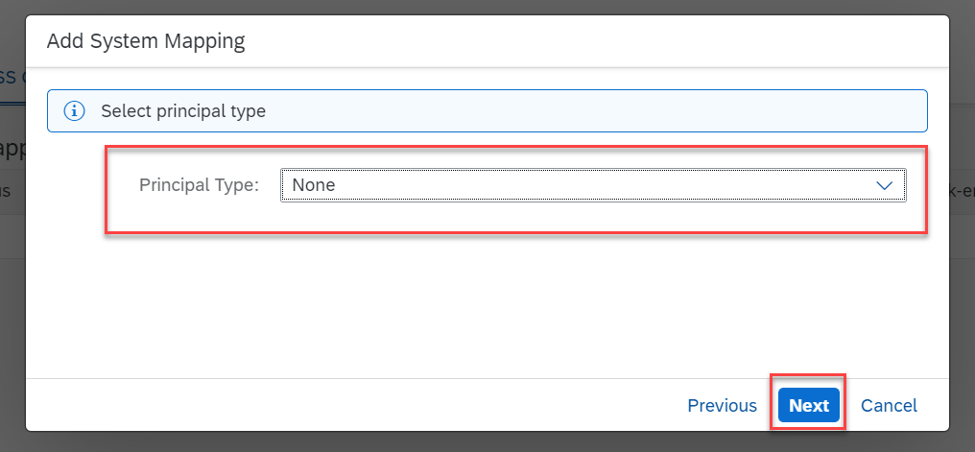
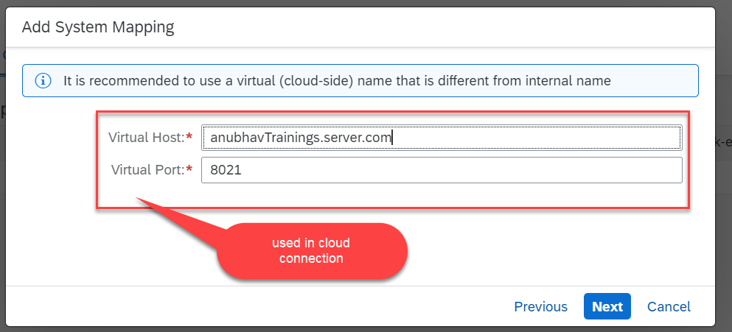
Cloud connector continue…
Step 6: Connect on-premise system to cloud using SCC

Slide 12
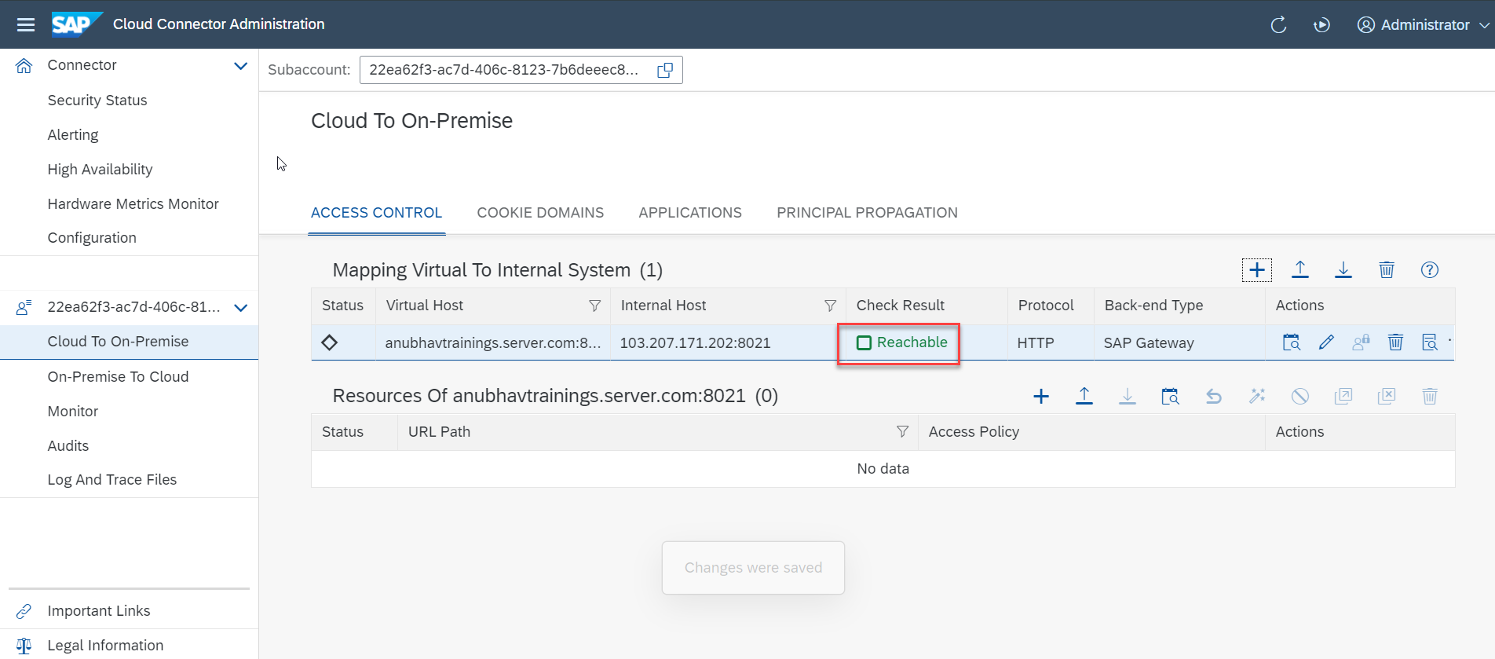
Cloud connector completed
We have Done with Connect , now we are now successfully connected to cloud using SCC.

Slide 13
CORS – Cross Origin Resource Sharing
It is a browser security policy which prevent us connecting to a domain while running web page on a different domain.
Browser
S
https://workspaces-ws-7qbs5-app3.eu10.trial.applicationstudio.cloud.sap/
Proxy
Facebook.com
Google.com
Another Server
http://103.207.171.202:8021/sap/opu/odata/sap/ZOCT_ODATA_SRV/$metadata
https://www.npmjs.com/package/@sap/ux-ui5-tooling

Slide 14
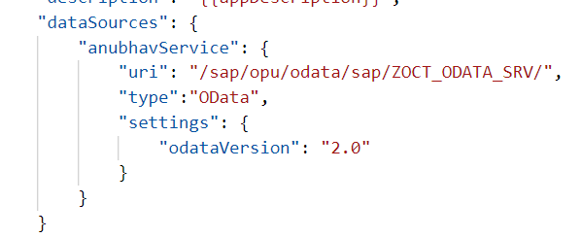
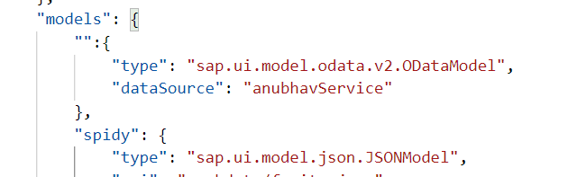
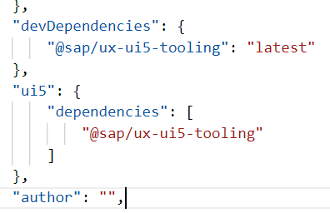
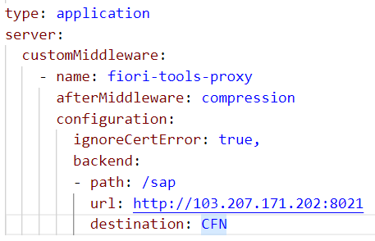
Integration of OData in our Fiori Project
Steps to Integrate our Fiori app with the OData service we have created.
Step 1: Go to manifest.json and define a data source in sap.app section.
Step 2: Go to sap.ui5 section and create a default data model for this data source
TO AVOID CORS issue in BAS tool so we can connect to our SAP SERVER
Step 3: Add a dev-dependency in package.json file to latest UI5 tooling - @sap/ux-ui5-tooling
Step 4: Also add a section called UI5 in package.json to use the tooling for the project.
Step 5: We will cheat the browser by adding a proxy module, this proxy module will re-direct all the calls starring /sap top our SAP Server via destination. In ui5.yaml file provide middleware configuration
Step 6: Test app using ui5 serve or fiori run command
Step 7: Binding with ODATA entityset

Slide 15
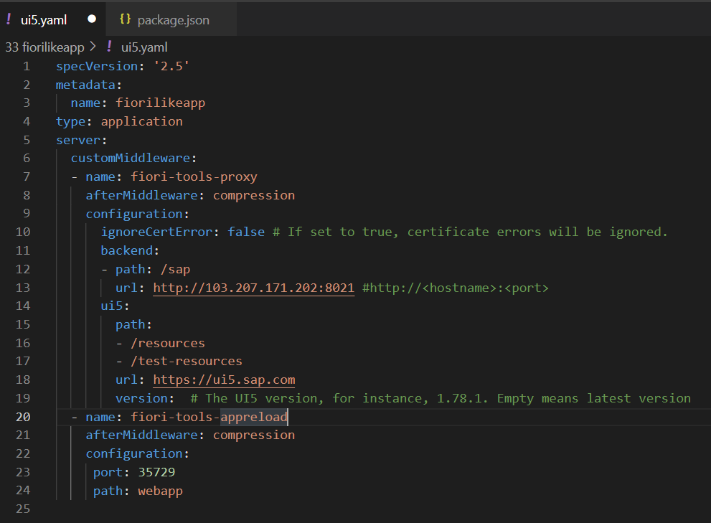
Configuring ui5.yaml for VS Code
To use the OData service in VS Code we must configure the ui5.yaml file according to that. We need to configure it according to the below format.
specVersion: '2.5'
metadata:
name: fiorilikeapp
type: application
server:
customMiddleware:
- name: fiori-tools-proxy
afterMiddleware: compression
configuration:
ignoreCertError: false
backend:
- path: /sap
url: http://<hostname>:<port>
ui5:
path:
- /resources
- /test-resources
url: https://ui5.sap.com
version:
- name: fiori-tools-appreload
afterMiddleware: compression
configuration:
port: 35729
path: webapp

Slide 16
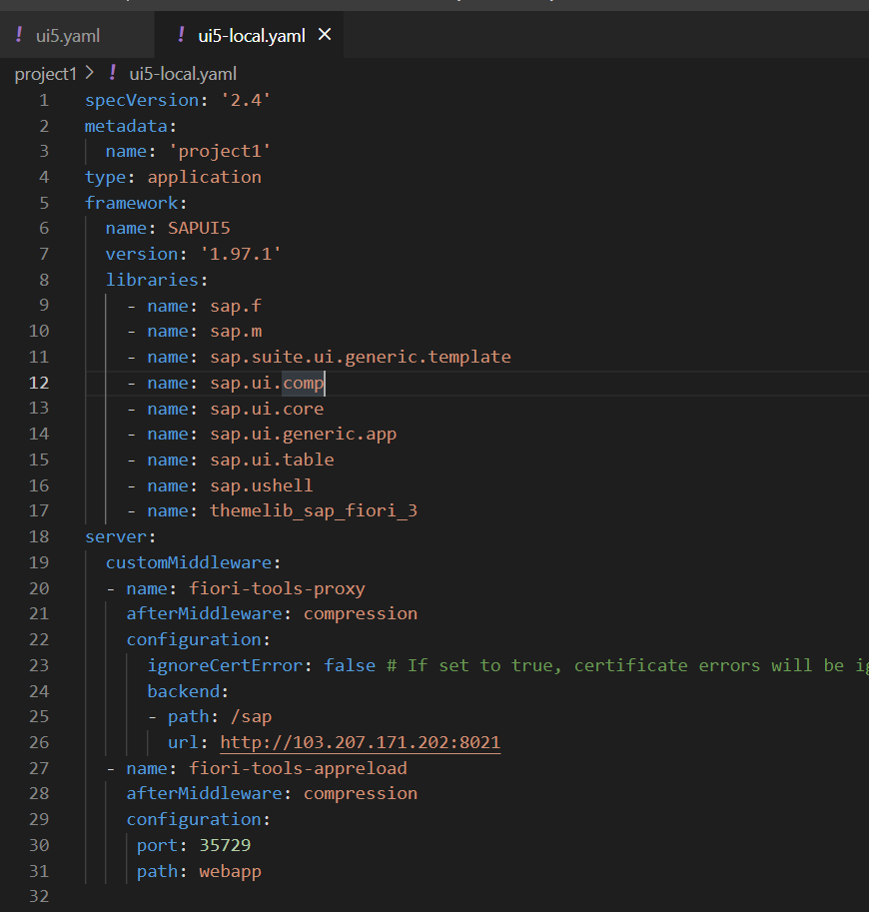
ui5-local.yaml configuration
To run and access the OData service in application in a local environment we also need a ui5-local.yaml file. The structure of ui5-local.yaml file is shown below:
specVersion: '2.4'
metadata:
name: 'project1'
type: application
framework:
name: SAPUI5
version: '1.97.1'
libraries:
- name: sap.f
- name: sap.m
- name: sap.suite.ui.generic.template
- name: sap.ui.comp
- name: sap.ui.core
- name: sap.ui.generic.app
- name: sap.ui.table
- name: sap.ushell
- name: themelib_sap_fiori_3
server:
customMiddleware:
- name: fiori-tools-proxy
afterMiddleware: compression
configuration:
ignoreCertError: false # If set to true, certificate errors will be ignored. E.g. self-signed certificates will be accepted
backend:
- path: /sap
url: http://103.207.171.202:8021
- name: fiori-tools-appreload
afterMiddleware: compression
configuration:
port: 35729
path: webapp

Slide 17

Exercise: Fiori Integration
In this exercise we will add the configuration to Integrate the OData with our existing app.
And we will bind the View1 with the OData model.
Along with that we will also see how to read the data of a single product.
To do that when we select a product form the product list then the details of that product will be loaded on the View2.
Exercise part 1 code/resource: Configuring the app to access OData and loading the list of products on view1
manifest.json
ui5.yaml
package.json
View1.view.xml
ui5.yaml and ui5-local.yaml config for VS Code
ui5.yaml
ui5-local.yaml
Exercise part 2 code/resource: Getting the data of single product with association To_Supplier on View2.
View1.view.xml
View1.controller.js
View2.view.xml
View2.controller.js
MoreInfo.fragment.xml

Slide 18
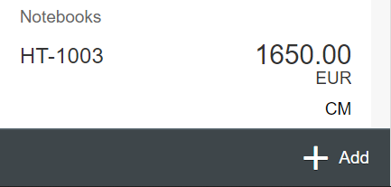
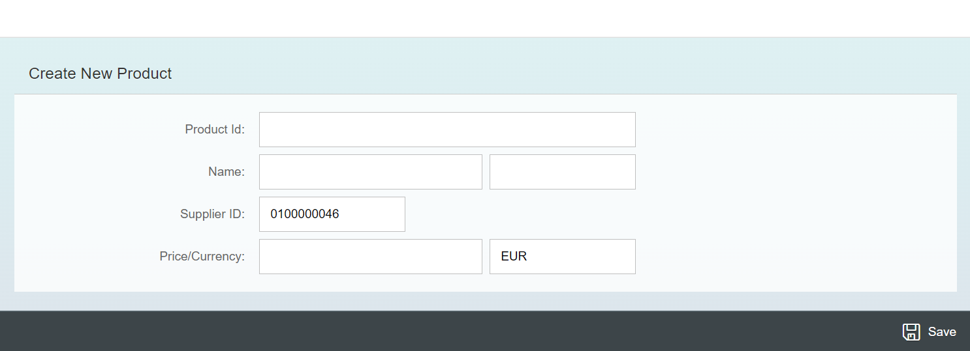
Exercise - Implement Create using UI
Now we will implement create operation in the UI. To do that we need to add a new screen in our application. In that screen we will add a simple form to fill the details of the product and a Save button in the footer of that page.
For this have to a new Add button in the footer of the View1 and on press of that button we will navigate to the new Add View.
Exercise code/resource:
View1.view.xml
View1.controller.js
Add.view.xml
Add.controller.js
manifest.json

Slide 19

Exercise – Implementing Update and Delete
Now we want to Update and Delete the selected record form the backend. To do that we will load the data of the record. Once the data is loaded to update and delete the data, we will add two buttons in the footer of the view named as Save and Delete. We will also add a clear button to clear the data of form.
On entering the Product ID of the product in the Input field and press enter we will load the data of that product in the Form.
Exercise code/resource:
Add.view.xml
Add.controller.js

Slide 20
Exercise – Using Function Import from UI
Now we want to Call the function import form the UI. To do that we will add a button near the Product Id input field. On press of that button, we will load the most expensive product in the form.
Exercise code/resource:
Add.view.xml
Add.controller.js

Slide 21

Introduction to Git and GitHub
Git is a version control system that lets you manage and keep track of your source code history.
GitHub is a cloud-based hosting service that lets you manage Git repositories.
Git HUB is a central repository to store all the code. Git is a distributed repository management system, which allows development teams to organize and sync their development code.
Use Case- I am working as a Fiori Developer in an MNC and I want to share my code with fellow developers, currently I am downloading the zip/tar file and sharing over email.
This way we will have piles of emails in our account,
especially when we work in a team of size 40 developers it becomes very hard to sync changes.
There is version control. Last night my app was stable, I made some changes this morning which messed up the whole project. I some how pray to god that can you please take me in past.
In a big team, many developers touching each other’s code and it’s hard to blame someone who disrupt the code.
It is also very hard to merge changes when done in same file.
As a developer, I am using BAS today, tomorrow I will use VS Code and next day Web IDE and very next week Atom. How can I easily port my code between these tools.
You can install git in local machine using below link (however, it comes along with all dev tools)
https://git-scm.com/downloads

Slide 22


How GitHub Works and commands in Git
We will see some important commands related to Git and will see how GitHub works.
Some important commands to use git.
git Init: It is used to initialize a new Git Repository in the system.
git add <filename>: It is used to stage the changes of the file to git repository. We can use ‘git add .’ to stage the changes of all files.
git commit: It is used to commit all the staged changes with a message.
git reset hard: Discard all the staged changes and discard the changes in all the files.
git push: It is used to push all the changes in the git repository.
git pull: It is used to pull the new changes made by other users in the project.
git status: It is used to check the status
git clone: It is used to clone a repository.
git remote add <repo URL>: Add a local repository to a remote repository.
Fiori Project (or any kind of project)
User (Anubhav)
But how all users will work on the project at a same time?
Anubhav’s local machine
Here GitHub comes into picture
Users which are working on the different parts of the same project on different Platforms (BAS, VS Code, Web IDE)
Project Repository
The project will be kept in a repository in the GitHub

Slide 23
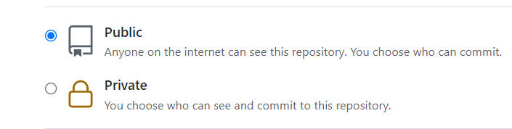
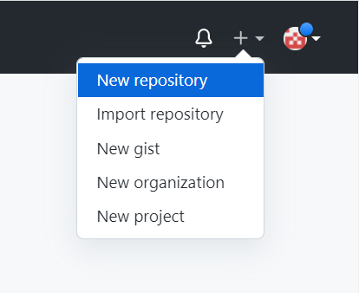
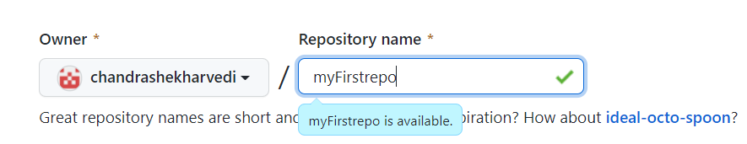
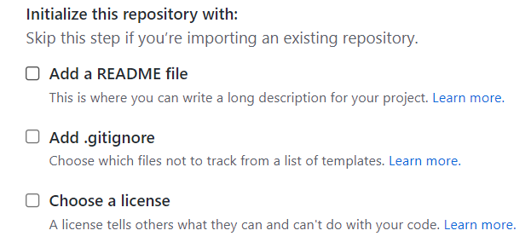
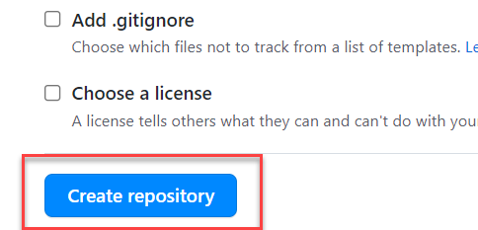
Steps to Create a new git Repository
Step by Step process to create a git repository in GitHub. First of all you must have a GitHub account, if not then go to this link https://github.com/signup?source=login and create a new Account.
Step 1: Click on the plus button in the top right corner of the screen and select ‘New Repository’.
Step 2: Type a short, memorable name for your repository. And give a description (optional).
Step 3: Select the type of repository. Public or Private
Step 4: Set how you want to Initialize the repository.
Step 5: Click on Create Repository. Your Repository will be created.
Repository Created Successfully

Slide 24


Adding project to git repository
Project on Local System
1
git init
Initialize a git repo
2
git add .
Stage all the changes
3
git commit –m “message”
git pull
Once the project is connected to git repo then we just use the git pull and git push commands to get the new changes and send our changes
Stage all the changes
git push
5
git add remote <repo URL>
Add the remote branch
GitHub Repository
git push
5
Clone repository for the first time in system
git clone <repo URL>
GitHub Repository

Slide 25
Jack
Romi
VS Code
BAS
commit
push
Github
project

Slide 26
Delivering Fiori Apps
Currently the Application we have developed is in our local system (VS Code or BAS). Now we want this app to be accessible by other people in our company, to do that we have to deploy this application to our ABAP environment or cloud platform where it can be accessed by others.
BAS/VS Code
GitHub
Development Team
destination
SCC
DEV
QLT
PROD
BSP App
BSP App
BSP App

Slide 27





Delivering Fiori Apps
2
ui5 build
Development Environment
(BAS, VSCode, etc.)
1
git push
dist
GitHub Repository
3
npm run deploy-config
Developer
deployment configuration
End Users
4
npm run deploy
ABAP Repository
PROD (P)
DEV
Quality(Q)
Transport Request
Transport Request
Admin
Launchpad and Launchpad Designer

Slide 28
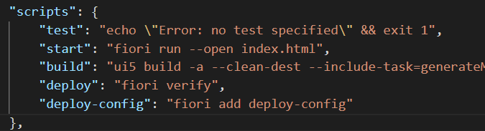
Adding deployment Configuration to App
Steps to configure the Application to deploy the Application on ABAP Environment.
Open the terminal in BAS or VS Code and go to your project folder.
Open terminal in you project folder.
Write command ui5 build or npm run build and press enter to build your project it will create a dist folder.
Now write command npx fiori add deploy-config to configure the project for deployment.
Select a target ABAP system … http://103.207.171.202 in your case your hostname will come in this step.
Enter the ABAP system client number …
Enter a username …
Enter a password …
Enter an application name …
Enter a description for the application …
Enter a package for the deployed application … $TMP
Now to deploy the application to the ABAP repository we use the command npm run deploy.

Slide 29
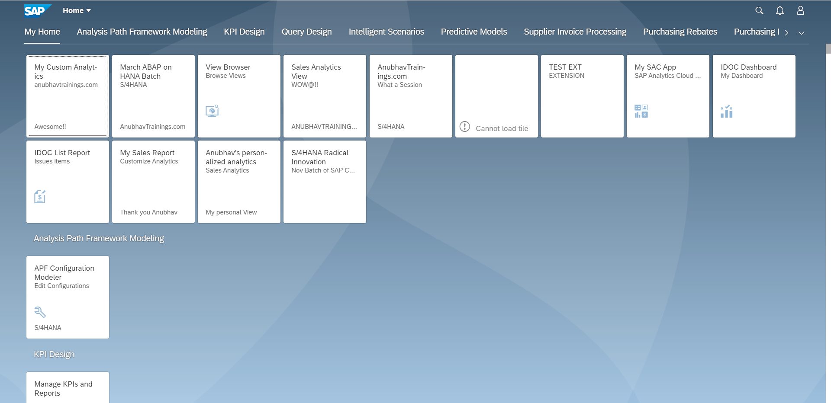
Fiori Launchpad
SAP Fiori Launchpad is a single access point for all the Applications in S/4HANA. Is available fiori frontend server once Fiori is installed in your SAP System.
The SAP Fiori launchpad is a shell that hosts SAP Fiori apps, and provides the apps with services such as navigation, personalization, embedded support, and application configuration.
The launchpad is the entry point to SAP Fiori apps on mobile and desktop devices. The launchpad displays a home page with tiles.
Each tile represents a business application that the user can launch. Tiles can also display live status indicators, such as the number of open tasks.
The launchpad is role-based. In other words, the user’s role determines which app tiles are shown.
Launchpad comes with Launchpad Designer (LPD), which allows developer/consultant to configure access to the apps as a Tile.
The TCode to access:
Launchpad: /N/UI2/FLP
Launchpad Designer: /n/UI2/FLPD_CONF

Slide 30
Why we require Launchpad
Just imagine, if my co. have developed 500 Apps in last Quarter, These 500 apps have got 500 URLs to access the app. As a end user, you would face below challenges
Finding URL for each app is a challenge
Making sure that you are right person to access app – Security
Also you should only be able to see apps which you are allowed to access
SAP Portal is now deprecated, what options do we have to access all functionality of ERP
Type of Fiori App Implementation
There are two types of Fiori App Implementations: Standard Apps and Customized Apps.
Standard Applications
Customized Apps
Implementation of those business apps, which are released by SAP
These are categorized as Transnational, Fact-sheets and Analytical apps etc.
As per business requirement, a complete custom fiori app can be implemented.
Customized App is been hosted on SAP-Fiori server (front-end system).
It integrates with SAP or Non-SAP system.

Slide 32
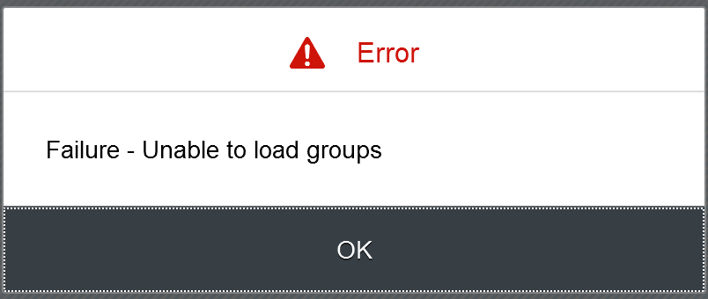
Fiori Launchpad Access
The service which is used by Launchpad to run
/UI2/INTEROP – This service controls navigation from tile to the Application
/UI2/PAGE_BUILDER_PERS – Launchpad personalization, Used to load all the tiles, groups of users, controls the loading of launchpad content for our users.
Trouble shooting:
The service is not even registered
The service is not even activate
You may not have authorization to access this service.

Slide 33
Basic Terms related to the Launchpad
Catalog – A Collection of all the Tiles, Each tile represent precisely one Application. We create catalog to package all tiles together according to team, functional area, application component, functionality, area of responsibility…
Tile – a square box which provides entry point for an app, it consists of 2 parts,
Tile Properties – title, subtitle, icon, ..
Intent - Semantic Object + Action
Semantic Object – The business object which is involved in the activity. Area of interest. E.g. SalesOrder, PurchaseOrder, OutboundDelivery, Customer, Vendor, Sales,..
Action – Define the purpose of our Fiori Application. Indicative of the Activity which we want to perform on Business object. E.g. Create, Change, Manage, Track, Maintain, Execute, Analyze
Intent ➔ SalesOrder-manage, OutboundDelivery-track
Note: Every application in entire system has unique intent.
3. Target Mapping – Maps the intent with the actual Fiori App, WeBGUI, Tcode, Webdynpro App.
4. Group – Is used to group tiles logically from business point of view, We never create tiles in group. We reference tiles in the group from catalog.
5. Role – A user will be granted a role and inside the role we will have the catalog and the group.
intent
Tile
Tile 1
Fiori App
Tile
Tile 2
Target Mapping

Slide 34
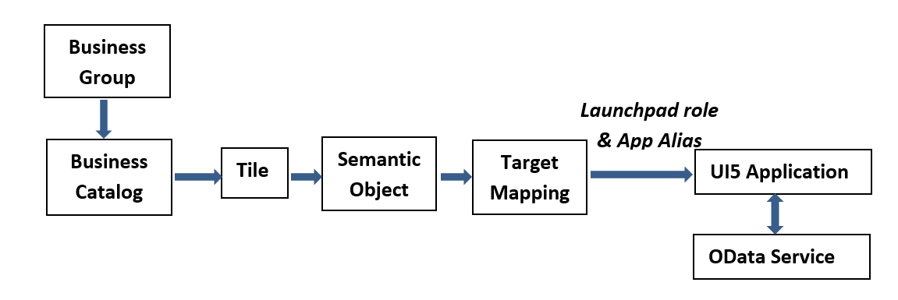
Relationship between Front-End Components

Slide 35
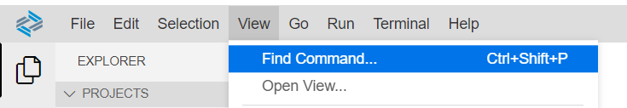
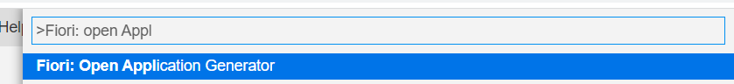
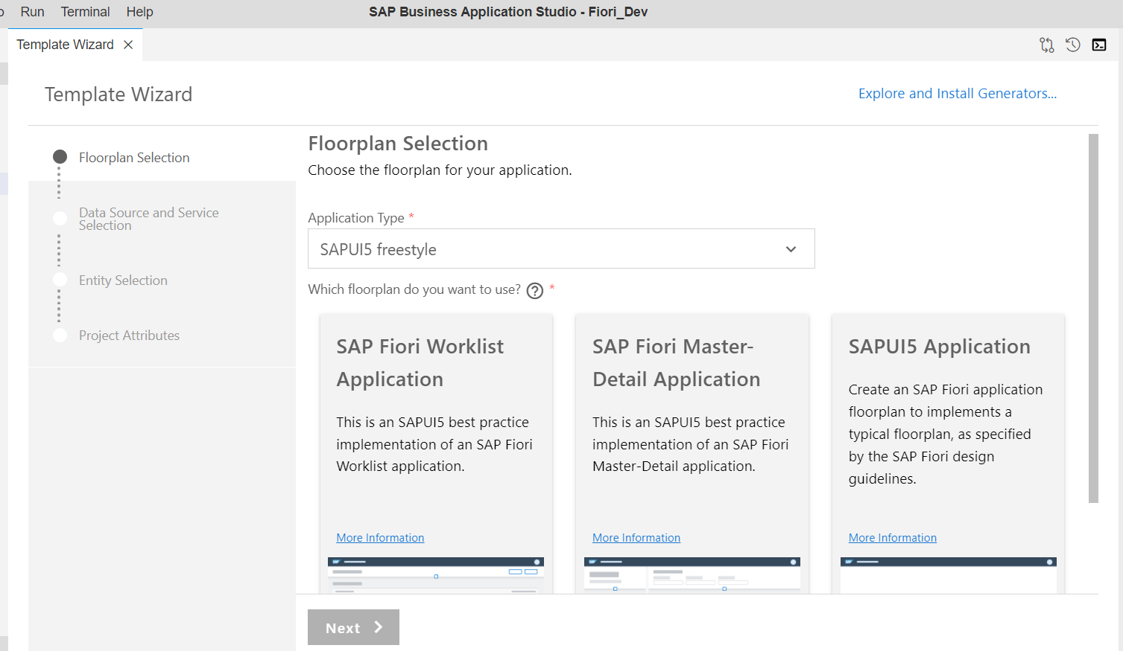
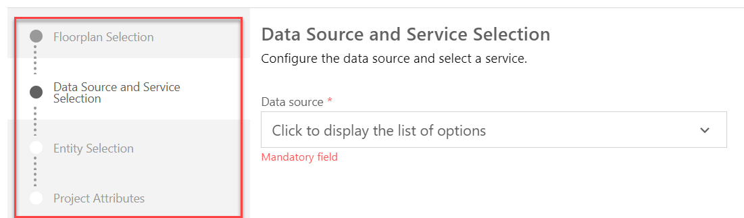
Creating Fiori App with Template in BAS
Steps to create a project using template in BAS.
Step 1: Click on the View tab and open the command pallet.
Step 2: In command pallet search for >Fiori: Open Application Generator and Select it.
Step 3: After Selecting it A new Template wizard will open. In the template wizard select the type of application and floorplan of the application and follow the configuration steps.
Step 4: Configure the Data Source and Service. Add the required Project attributes and Finish then your application will be generated.

Slide 36
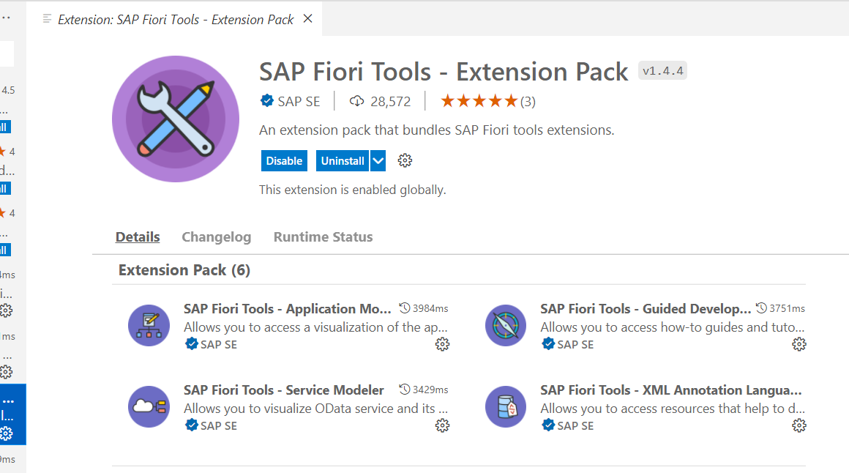
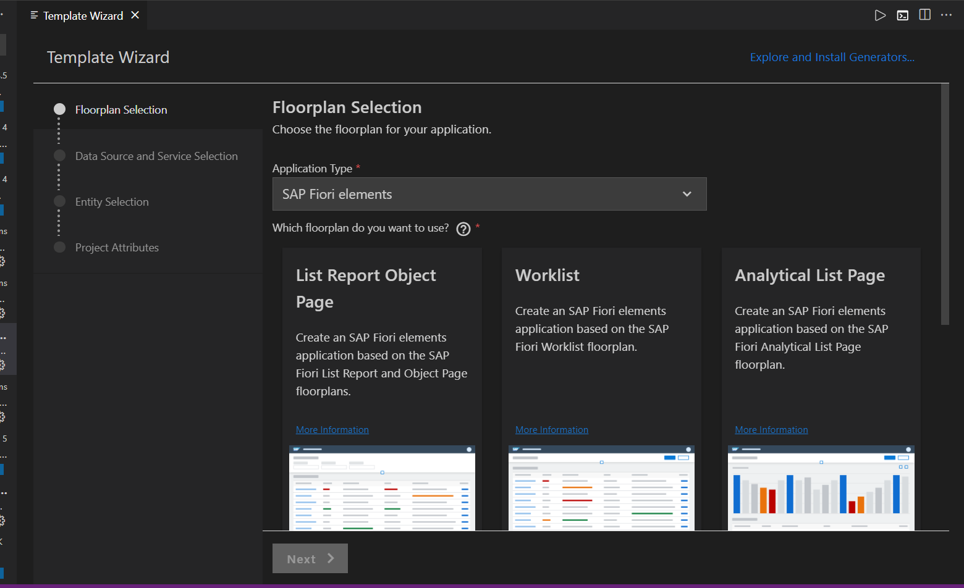
Creating Fiori App using Template in VS code
Before we start generating application in VS code, we need to verify that Fiori Tools are installed in our system or not. To do that we need to install an extension pack in VS code, which is SAP Fiori Tools – Extension Pack.
Once the installation of extension pack is completed, we can follow the same steps which are specified in the previous slide. In which we have generated the application using template in BAS.
When we open the Template Wizard in VS Code then, we will see a similar screen which we have seen in the BAS.

Slide 37
Fiori = UX Consistency
UX consistency
▪ Increases adoption of your app
▪ Improves business user productivity
▪ Decreases training time
▪ Improves data quality
▪ Enhances user satisfaction
SAP Fiori elements provides standard floorplans and uses metadata to streamline and accelerate developing SAPUI5 applications.
SAP Fiori elements
▪ Delivers enterprise-ready SAPUI5 apps based on
stable, optimized, out-of-the-box UI code
▪ Boosts developer efficiency by scaling development
and maintenance in a cost-efficient way
▪ Provides a centrally managed, consistent UX
complying with the latest SAP Fiori design
▪ Ensures upgrade stability and forward compatibility
▪ Allows extensibility of standard floorplans with custom
controls and logic

Slide 38
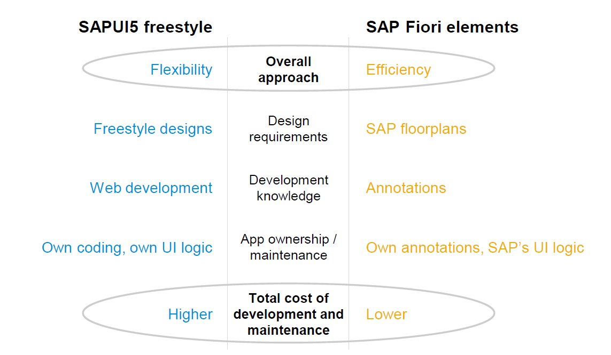
Free Style v/s Fiori Elements Apps

Slide 39
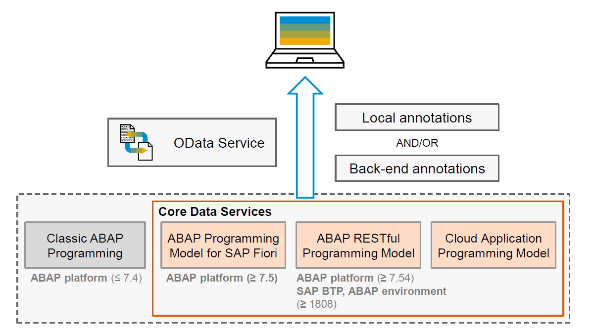
Big Picture – Architecture

Slide 40


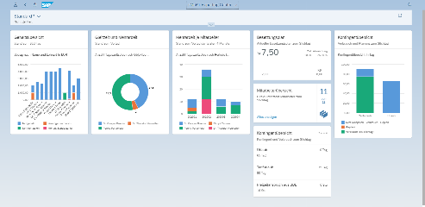





Developer Persona – Fiori Elements
Anubhav
Happy User
Rob
S/4HANA Technical consultant
ABAP Developer
Roxana
UX Designer | Fiori Developer
ABAP Dev. Tools
On
Eclipse
VS Code
BAS
OData Service
Fiori Elements Project
Annotations.xml
CDS Views
MDE
@

Slide 41
Annotations
Annotations are additional metadata and provide abstract definitions of data semantics. These abstract definitions are stored in vocabularies from OData and SAP. SAP Fiori elements understand the annotations and generates the UI based on them.
CDS View Annotations
XML Annotations
Annotations which are coding in ABAP system.
Require experience in ABAP on HANA and done by an ABAP or S/4HANA Consultants
CDS annotations follow the lifecycle of your OData
Service.
Due to different release cycles, some new annotations
might be available later in ABAP CDS.
More suitable if we use frameworks like RAP, & BOPF to build end to end applications
Project will be coupled with OData built on CDS hence we cannot test application if the service is down.
Easy to code and can be modularized with metadata extensions in CDS.
Use ADT tool to code the same.
Coded inside the annotations.xml file inside a Fiori Application
Require understanding of XML in general and knowledge of annotations
XML annotations follow the lifecycle of your app (local project)
With latest UI5 release, we can use new features
Suitable if we use SEGW based services, Or other frameworks which does not support the annotations.
UI projects are decoupled from the CDS and services and can be tested and transported independently.
Easy to work with the help of annotation modeler extension pack
Use BAS or VS Code to develop same.

Slide 42
Fiori Elements - List Report Application
The list report offers powerful features for finding and acting on relevant data sets. It is often used as an entry point for navigating to the item details, which are usually shown on an object page.
List Report
Object Page

Slide 43
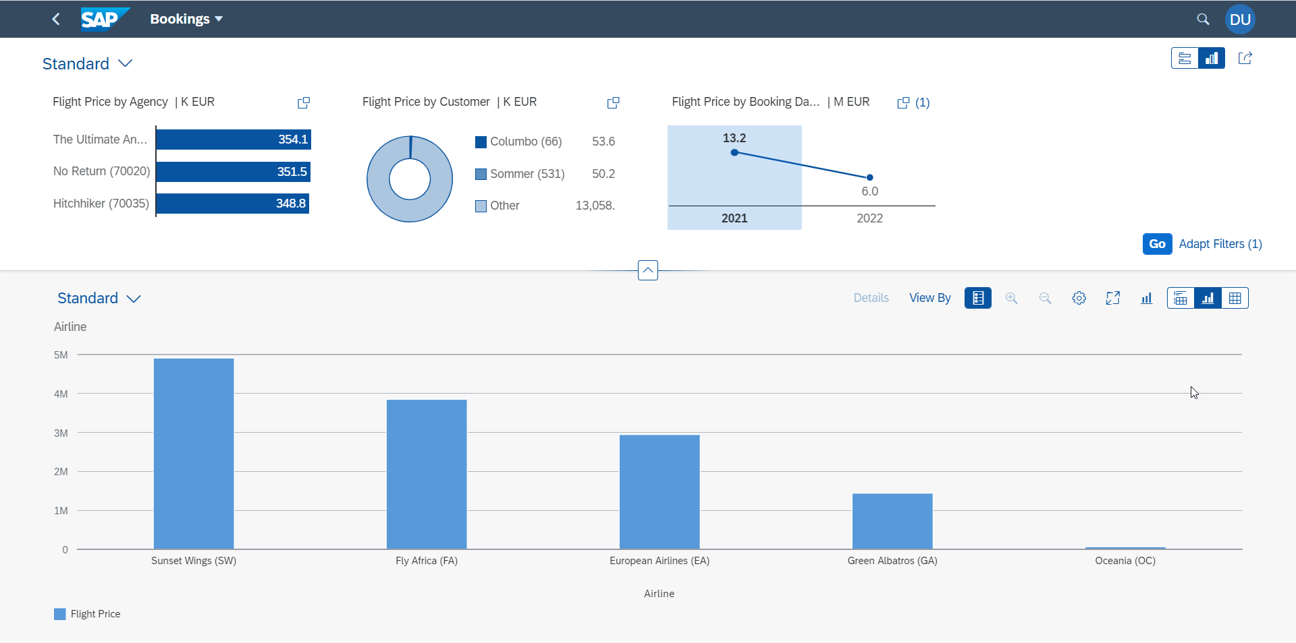
Fiori Elements - Analytic List Page
A ALP is used to display analytics as well as line item data in list. We can analyze data distribution across multiple dimensions for our measures. It also allows along with filter bar a special types of filter called visual filter.

Slide 44

End of Day 17

Slide 45

Questions

Slide 46

Anubhav Oberoy

Slide 47


We’re committed to empower you to be
Most Desirable Resource
through powerful training solutions.
We build the workforce of the future.
250+
Corporate Clients
30,000+
Learners Trained
25000+
Learners Placed
FREE WEBINARS
Sign up for free webinars with industry experts every fortnight!
Enroll Now!
Contact us today!
https://anubhavtrainings.com/

Slide 48




More from AnubhavTrainings.com

Slide 49
Title
Content

